Slide 1

AIML Part A CA1
Randal Hong
DAAA/FT/1B/03

Slide 2
Overview of the workflow
1. Background Research and Importing Data
2. Preprocess Data
3. Hypertune Models
4. Select Best Model and Test And Score
5. Conclusion
- Understand data
- Retrieve data
- Remove duplicative data (if any)
- Remove outliers (if any)
- Impute missing data (if any)
- Scale data by Standardisation
- Select hyperparameters to tune for each model
- Find the best hyperparameters for each model
- Choose best model from the scores
- Test and score with test data
- Compare final model with a dummy baseline
- Determine which features are deemed important by the model

Slide 3
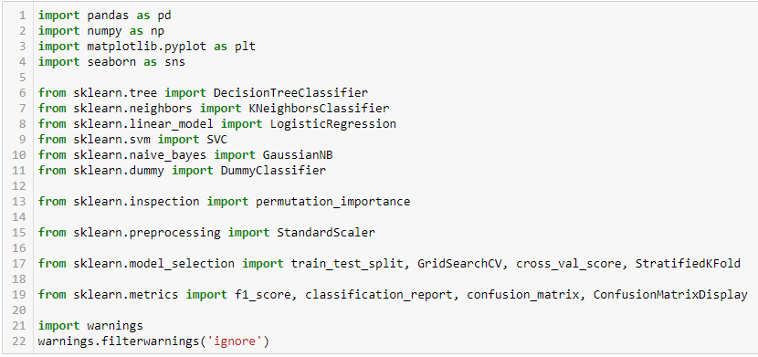
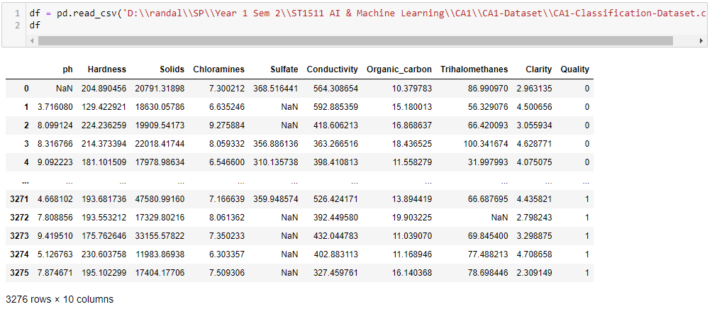
1. Importing Data
We will first import all the required modules
Then we will load the data

Slide 4
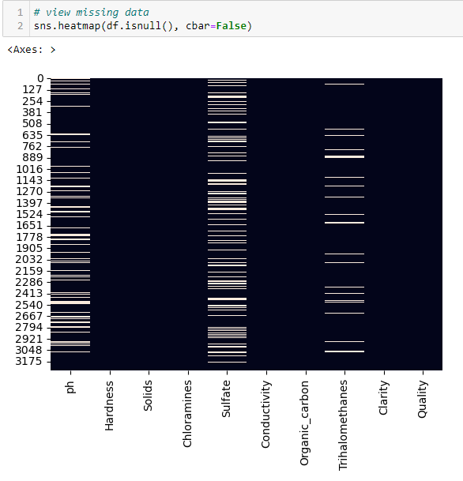

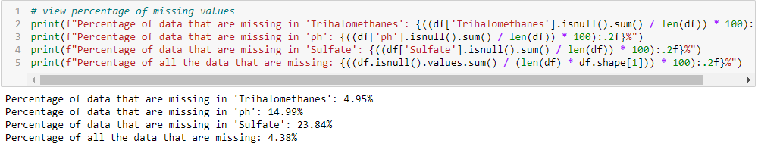
2. Preprocess data – Check for missing/duplicative data
Since there is no data in the DataFrame for duplicated data, we can say that there is no duplicative data
We can check for missing data by using Seaborn’s heatmap
We will calculate the proportion of missing data to determine whether to drop or impute them
As the percentage of missing data for each feature is quite high (>= 5%), we will not drop the data but instead impute them

Slide 5
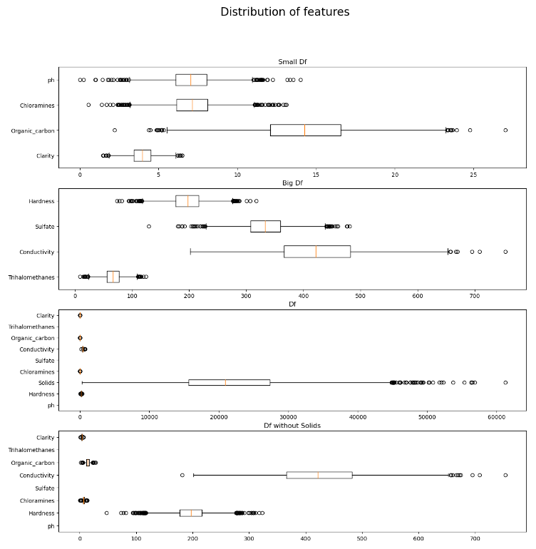
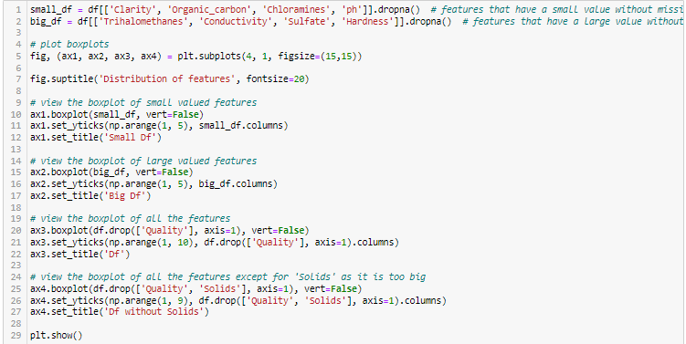
2. Preprocess data – Check for outliers
Before we impute the missing data, we must first remove potential outliers as they will affect the imputed value
We can visualise the distribution of the data using matplotlib’s boxplots

Slide 6
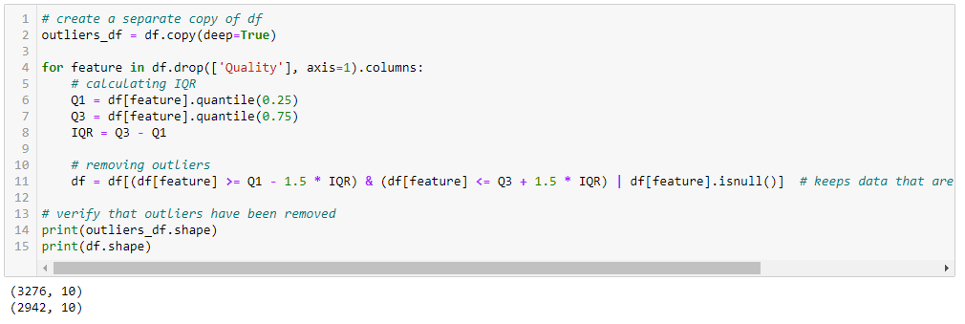
2. Preprocess data – Remove outliers
As there are quite a few outliers for each feature, we will remove the outliers
We will first create a copy of the DataFrame with all the outliers for later use
We can remove the outliers for each feature by calculating the upper and lower fence and filtering out data that are outside of these fences

Slide 7

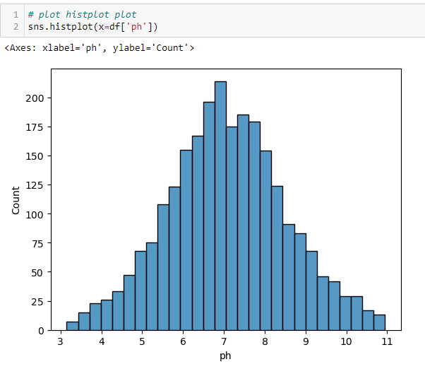
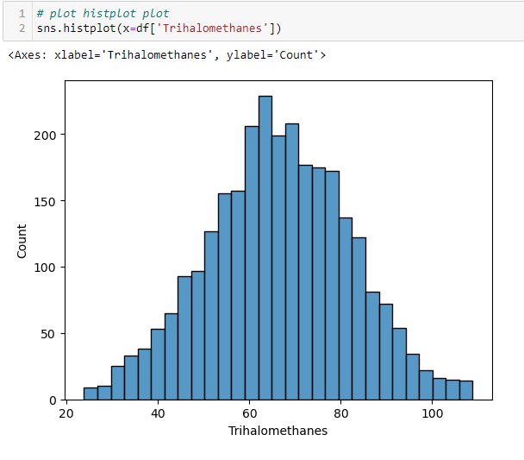
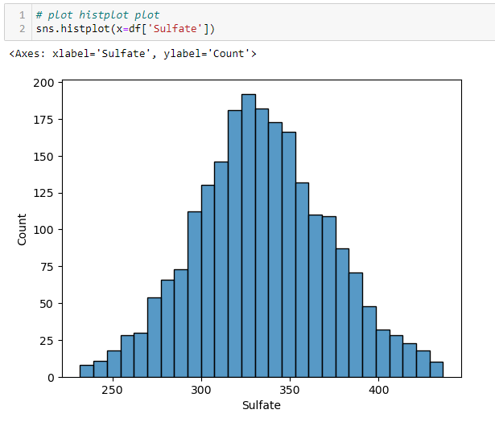
2. Preprocess data – impute missing data by mean
After removing the outliers, we need to decide which imputation method to use: either median or mean
We can do so by viewing the distribution of features with missing data using Seaborn’s histoplot
As they all are mostly normally distributed, we can use mean as our method of imputation
We can impute the missing data by mean by looping through each feature
We will do this imputation of missing data for both the DataFrame with outliers and without outliers

Slide 8
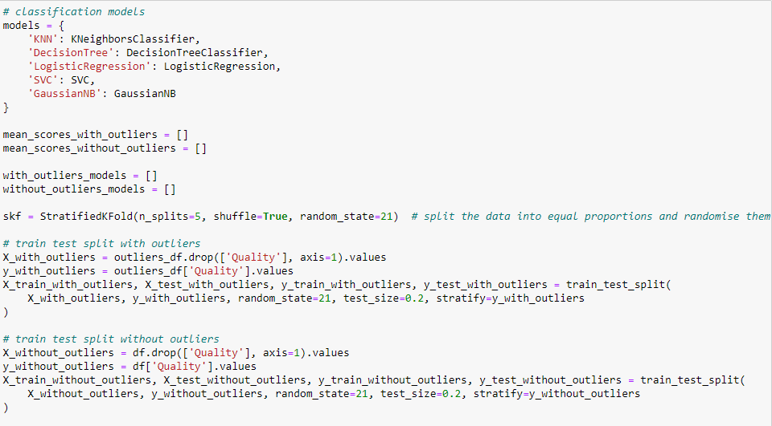
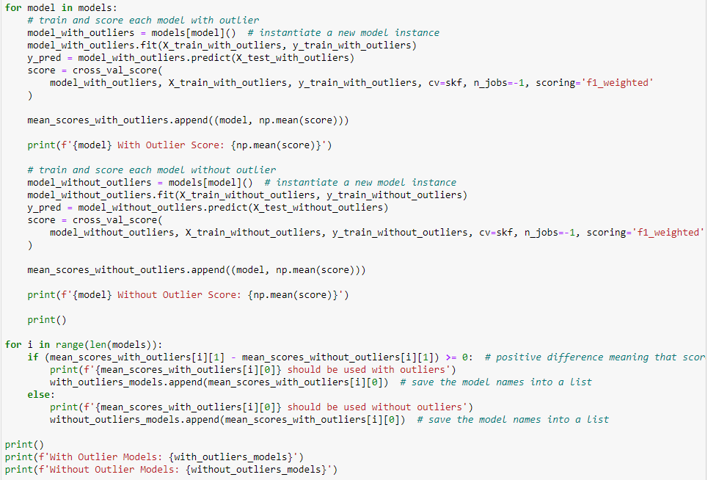
2. Preprocess data – test which model works better with or without outliers
As I am unsure how removing the outliers or not will affect the model’s performance, we will take both datasets and compare their scores
We will first create our models in a dictionary
Train test split each dataset
Loop through each model and perform cross_val_score() both datasets
Compare the f1_weighted scores for each datasets

Slide 9
2. Preprocess data – deciding on a scoring metric to test and score models
We initially used f1_score for the scoring of cross_val_score instead of other scoring methods such as accuracy. For example, we want to correctly predict the quality of water. Be it 0 or 1, we want to get the correct prediction. However, the formula for accuracy is TP / (TP + TN). This only accounts for the number of correct 1s we predicted and not the number of correct 0s we predicted. On the other hand, the formula for f1_score is F1 = (2 × TP) / (2 × TP + FP + FN) or F1 = (2 × Precision × Recall) / (Precision + Recall) which takes into account the false positives and false negatives.
However, when I used f1_score for the scoring of cross_val_score, it gave me a score of 0 for Logistic Regression. After printing out its predictions, I realised that it predicted all 0 for the target. This is because the distribution of the target is inbalanced (not 50-50) and there is more data in the dataset that trains the model to predict 0 than 1 which can be shown by the countplot below. As the model predicts all 0s, the number of TP is 0 and thus F1 score is 0.
Hence, we decided to use weighted_f1 for the scoring of cross_val_score as it assigns weights to each class based on the number of instances in that class which gives a score representative of the imbalance in the class.

Slide 10
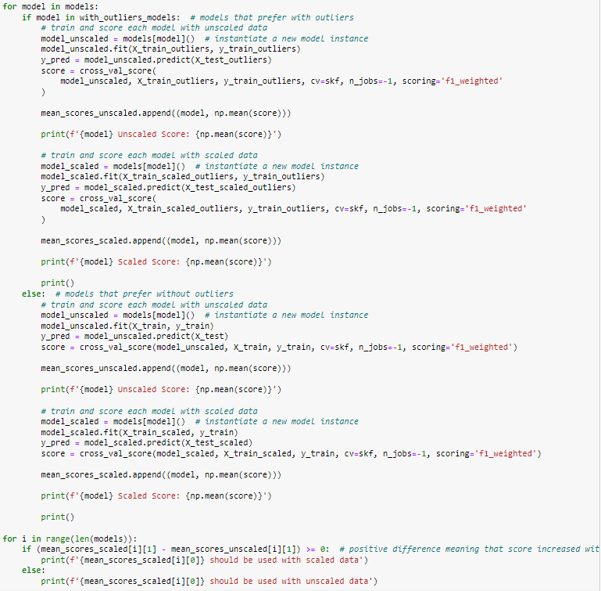
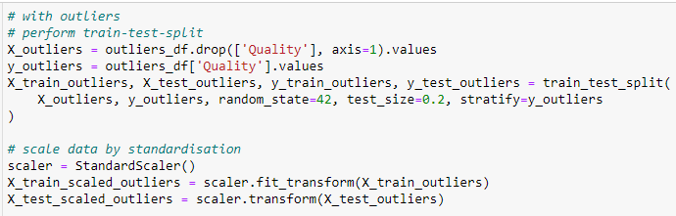
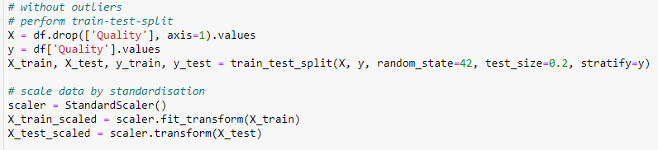
2. Preprocess data – scale features using standardisation
As some models like KNN depends heavily on distance between data points, we will scale the data using standardisation
However, not all models may favour scaled data. Hence, we will perform cross_val_score and compare the f1_weighted scores to see which model favours which type of data

Slide 11
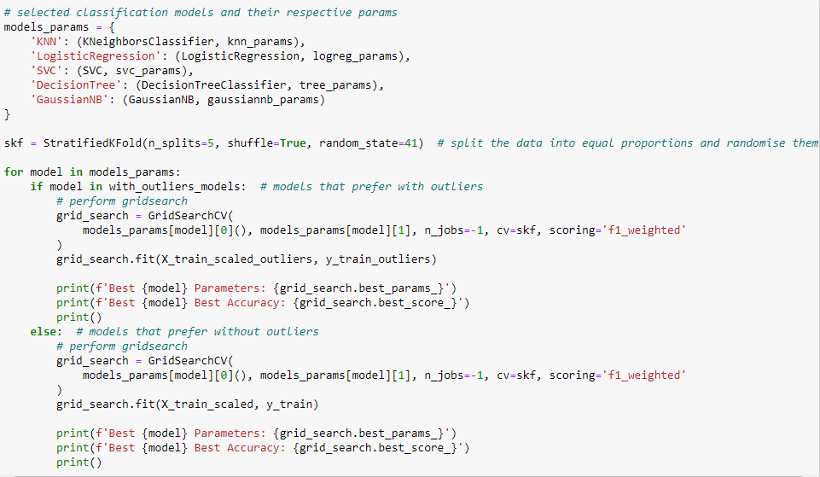
3. Hypertune models
As all the models prefer scaled data, I will only be using scaled data to fit and test the model
I have also created two lists consisting of the models’ names: one which consists of models that prefer dropping outliers and the other with models that prefer not to drop outliers
This is so that I can hypertune these models with their favoured dataset to get the highest possible score
After selecting which hyperparameters we want to tune for each model and their respective values, we can use GridSearchCV to find all the possible combinations and select the best instead of RandomSearchCV as it will not search for all possible combinations

Slide 12
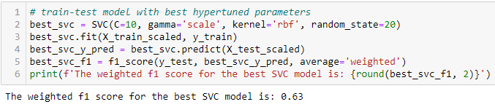

4. Selecting best model and test and score
From the GridSearchCV, SVC had the highest f1_weight score. Hence, we will use SVC for our best model
However, the score that we got from GridSearchCV is not accurate as it was tested against data that the model has already seen before
Thus, to truly test the model’s performance, we will need to test it against X_test, which contains data that the model has not seen yet

Slide 13
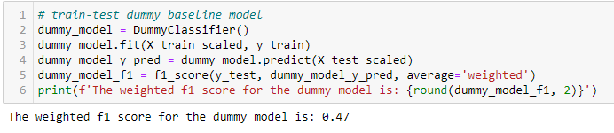

5. Conclusion – test and score dummy baseline model
To compare our best model with a dummy baseline, we can use DummyClassifier() and test and score it
We will also fit the dummy baseline model with the same type of data (without dropping features) so that it is a fair comparison with the best SVC model

Slide 14
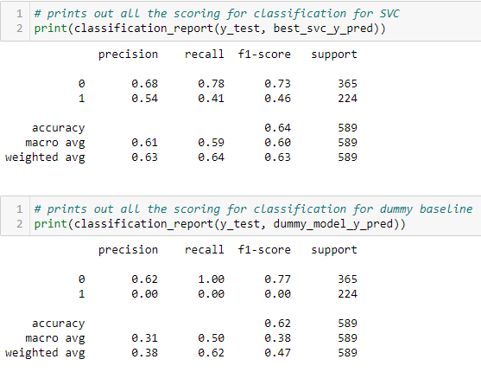
5. Conclusion – compare best svc model to dummy baseline model (f1_weighted score & classification report)
From the f1_weighted score difference, we can tell that our SVC model outperforms the dummy baseline model by 0.15, or about 32%
We can also tell from the classification report for SVC that the model is much better at predicting bad water qualities but not good water qualities

Slide 15
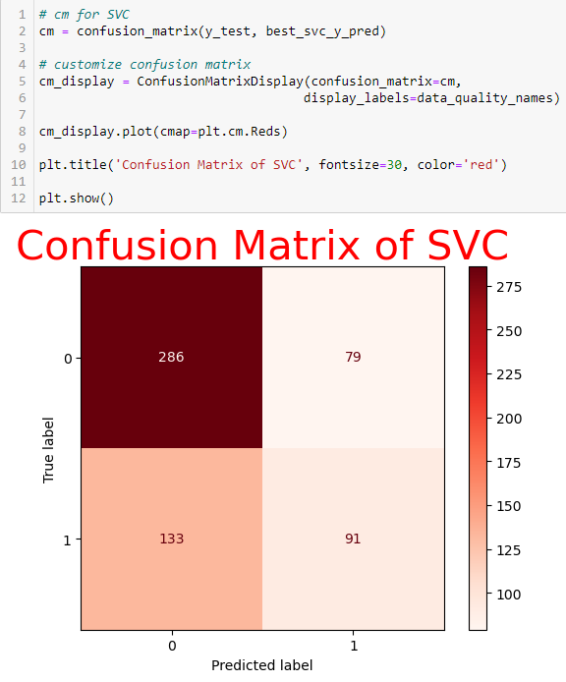
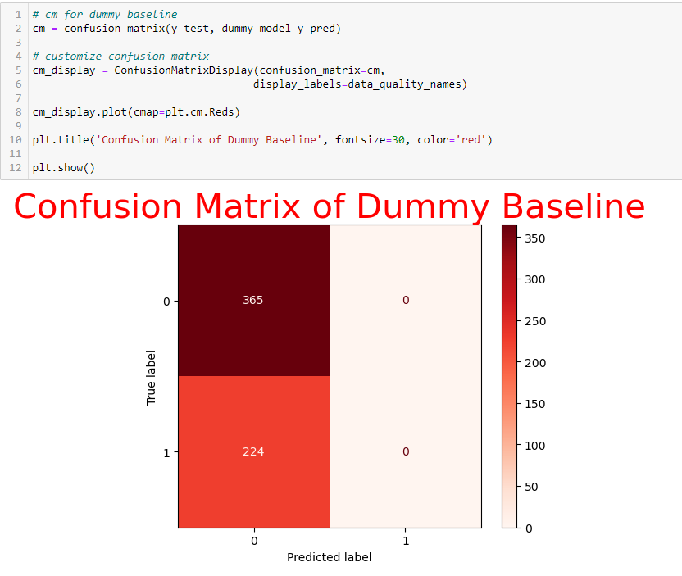
5. Conclusion – compare best svc model to dummy baseline model (Confusion matrix)
From the confusion matrix for the dummy baseline model, we can tell that it just predicts all the water quality to be 0
This could be because there is an imbalance in the distribution of the target feature where majority are 0s (meaning there are more 0s than 1s)

Slide 16
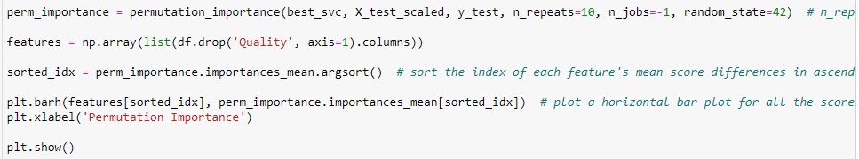
5. Conclusion – determining which features the svc model considers important
permutation_importance takes a trained model and permutates each feature and scores the model
It will then compare the scores between the model without permutated features and the model with permutated features to see whether the features affects the score of the model
If there is a significant difference in the scores, it means that the feature has a great impact on the model's performance and hence is important
The function will repeat this step for n_repeats number of times before it permutates the next feature and so on
It can only be used for models with a rbf kernel, but since our SVC model happens to be using it, we can use permutation_importance to do so

Slide 17
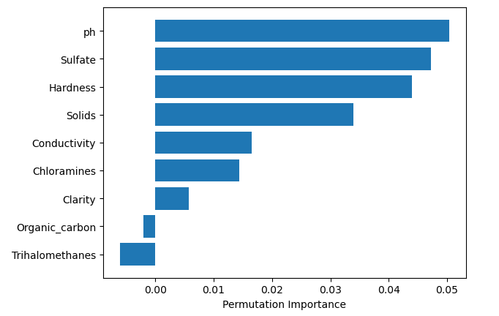
5. Conclusion – determining which features the svc model considers important
From the horizontal bar plot shown, we can tell that the top 3 features that are deemed important by the SVC model are pH, Sulfate and Hardness in determining the quality of water
The negative permutation importance scores for Organic_carbon and Trihalomethanes means that they perform better when randomized, suggesting that they are not important

